Slide 1
Arrays and Strings

Slide 2
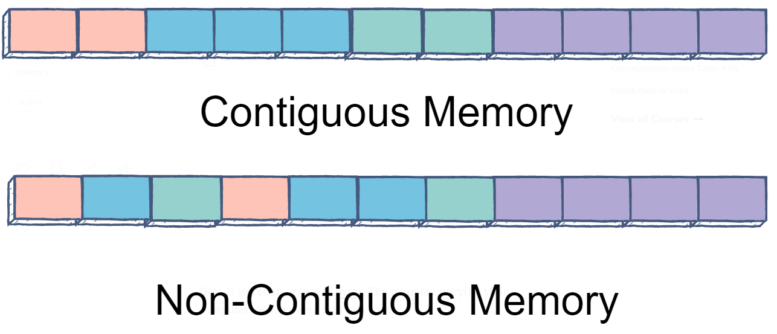
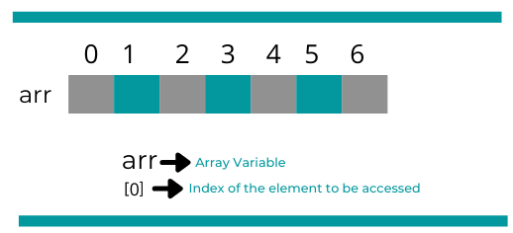
Arrays
An array is a collection of similar data elements stored at contiguous memory locations. It is the simplest data structure where each data element can be accessed directly by only using its index number.
Notes:
An example is a student doing 5 subjects their marks will be stored marks[4]

Slide 3
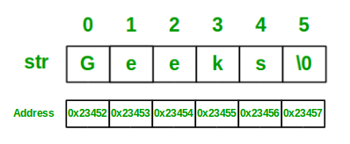
Strings
These are an array of characters.
The difference between a character array and a string is the string is terminated with a special character ‘\0’

Slide 4
Hash tables
A hash table is a data structure that maps keys to values for highly efficient lookup.
Hash Table is a data structure which stores data in an associative manner. In a hash table, data is stored in an array format, where each data value has its own unique index value. Access of data becomes very fast if we know the index of the desired data.
Notes:
H

Slide 5
arr{8}
“Paul” = 15 mod 8 =7
Key | Value
“Paul” | 29
“Jane” | 35
“Chloe” | 88
“Alex” | 8
 |  |  |  |  |  |  | Paul 29
Notes:
This is a dictionary
One can perform search, insert, delete
We can use a hash table to implement those operations

Slide 6
h1(“Paul”) = 7
A hash function should be: i) Fast to compute
ii) Avoid collisions
Key | Value | Index
“Paul” | 29 | 7
“Jane” | 35 | 1
“Chloe” | 88 | 2
“Alex” | 8 | 0
Notes:
What if we had names like Jane, Josh, Jenifer?

Slide 7
Linear Probing
Key | Value | Hash | Hash Index after Linear probing
1 | 20 | 1 % 5 = 1 | 1
2 | 70 | 2 % 5 = 2 | 2
42 | 80 | 42 % 5 = 2 | 3
4 | 25 | 4 % 5 = 4 | 4
12 | 44 | 12 % 5 = 2 | 5
(1,20)
(2,70)
(42,80)
(4,25)
(12,44)
1 20 | 2 70 | 42 80 | 4 25 | 12 44

Slide 8
Chaining
1 20 | 12 44 |  | 4 25
42 80
2 70

Slide 9
ArrayList & Resizable Arrays
An Arraylist is an array that resizes itself as needed while still providing 0( 1) access. A typical implementation is that when the array is full, the array doubles in size. Each doubling takes 0( n) time, but happens so rarely that its amortized insertion time is still O ( 1).

Slide 10
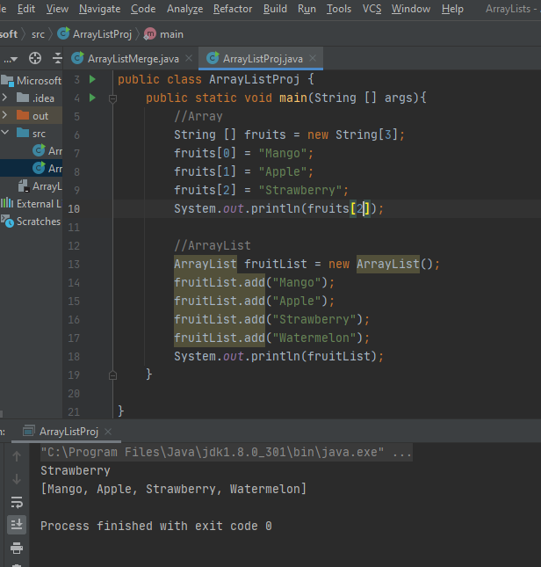
Notes:
An arrayList shrinks and grows an example could be Youtube subscribers
It avoids wastage

Slide 11
StringBuilder
Java provides three classes to represent a sequence of characters: String, StringBuffer, and StringBuilder.
In Java, String objects are immutable. Immutable simply means unmodifiable or unchangeable.
Once a string object is created its data or state can't be changed but a new String object is created.
A String that can be modified or changed is known as mutable String. StringBuffer and StringBuilder classes are used for creating mutable strings.
The Java StringBuilder class is same as StringBuffer class except that it is non-synchronized.
Notes:
One has to explicitly assign it to the reference variable
An example is like the password and username they are immutable

